Slide 1
The tree map
The tree map

Slide 2
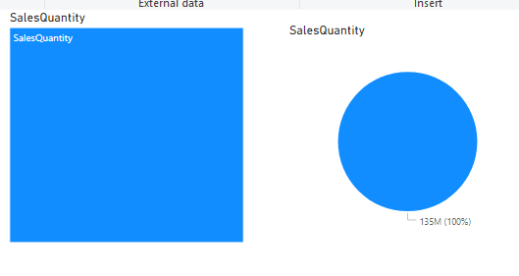
The tree map
Add the TreeMap and Pie visualizations to the scene level and configure both visualizations to display the order quantity from FactInternetSales

Slide 3
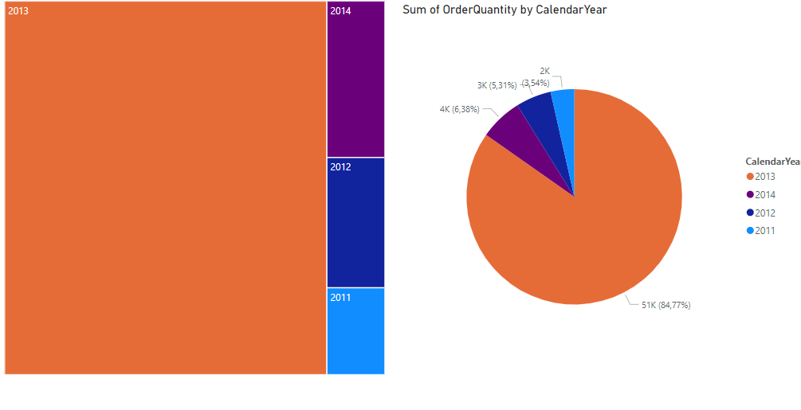
The tree map
Note that to configure TreeMap there is a difference compared to Pie in that the Legend parameter becomes Category in the case of TreeMap

Slide 4
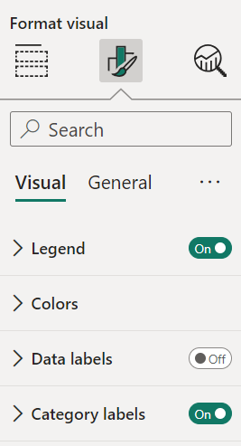
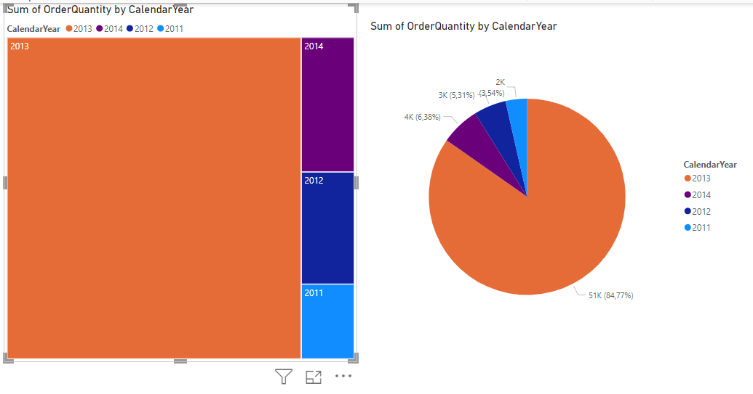
The tree map
Add a legend to the TreeMap level by selecting the Format section then activation Legend

Slide 5
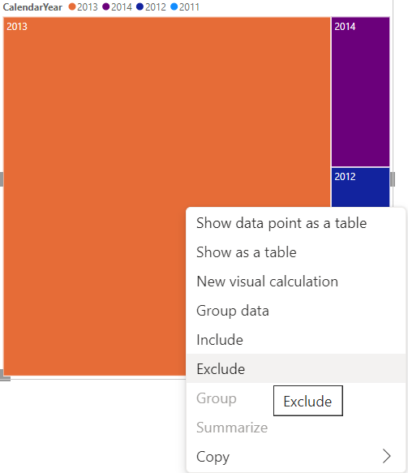
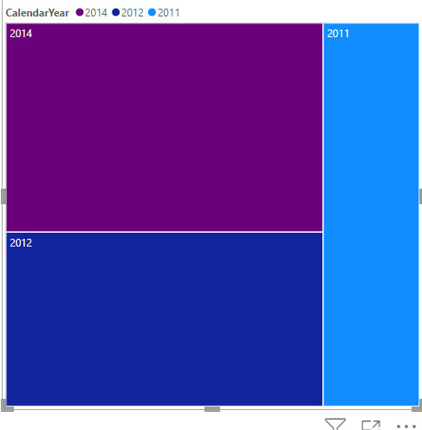
The tree map
It is possible to exclude or include sectors in both cases of visualizations , by right-clicking and selecting include or exclude

Slide 6
Thank you
Thank you

